Slide 1

UNIVERSITY INSTITUTE OF ENGINEERING
COMPUTER SCIENCE ENGINEERING
Bachelor of Engineering (Computer Science & Engineering)
Subject Name: Big Data Analytics
Subject Code: 20CST-471
Distributed machine learning
Mapped with CO5
Prepared By:
Er. Ankita Sharma
DISCOVER . LEARN . EMPOWER

Slide 2
Distributed machine learning
Feature engineering and model evaluation are crucial steps in the machine learning pipeline, and their significance is magnified in the context of big data.
Dealing with large and complex datasets requires thoughtful feature engineering and robust model evaluation techniques to ensure the effectiveness and efficiency of the machine learning process.

Slide 3
Dimensionality Reduction:
Techniques: Use methods like Principal Component Analysis (PCA) or t-Distributed Stochastic Neighbor Embedding (t-SNE) to reduce the number of features while retaining important information.
Categorical Variable Encoding:
Techniques: Apply one-hot encoding, label encoding, or feature hashing to represent categorical variables in a format suitable for machine learning models.
Text Data Processing:
Techniques: Tokenization, stemming, and vectorization are essential for handling text data. Convert text into numerical representations using techniques like TF-IDF or word embeddings.
Time-Series Feature Extraction:
Techniques: Extract meaningful features from time-series data, such as lag features, rolling statistics, and Fourier transforms.

Slide 4
Handling Missing Values:
Techniques: Impute missing values using statistical measures, or employ advanced imputation methods such as k-nearest neighbors or data-driven imputation models.
Feature Scaling:
Techniques: Normalize or standardize numerical features to bring them to a common scale, ensuring that no particular feature dominates the model due to its scale.
Interaction and Polynomial Features:
Techniques: Create interaction features or polynomial features to capture non-linear relationships between variables.
Binning and Discretization:
Techniques: Group continuous numerical variables into bins or discrete intervals to handle non-linearity and improve model performance.

Slide 5
Domain-Specific Feature Engineering:
Techniques: Leverage domain knowledge to create features that encapsulate specific patterns or characteristics relevant to the problem at hand.
Feature Importance and Selection:
Techniques: Use algorithms or techniques (e.g., Recursive Feature Elimination) to identify and select the most relevant features for modeling.

Slide 6
Model Evaluation in Big Data:
Train-Test Split in Big Data:
Challenge: Traditional train-test splits may not be feasible with extremely large datasets.
Solution: Use techniques like cross-validation or bootstrapping to assess model performance on multiple subsets of the data.
Cross-Validation:
Techniques: Implement k-fold cross-validation, stratified cross-validation, or time-series cross-validation to robustly evaluate model performance.
Parallelization for Model Evaluation:
Challenge: Traditional model evaluation can be time-consuming on large datasets.
Solution: Leverage parallel computing and distributed frameworks to speed up cross-validation or hyperparameter tuning.

Slide 7
Metrics for Imbalanced Datasets:
Challenge: Imbalanced datasets can lead to misleading evaluation results.
Solution: Use metrics such as precision, recall, F1 score, or area under the precision-recall curve (AUC-PR) to account for imbalances.
Handling Streaming Data:
Challenge: In scenarios with streaming data, traditional batch-based evaluation methods may not be applicable.
Solution: Implement online evaluation metrics and techniques suitable for streaming data, continuously updating model performance.

Slide 8
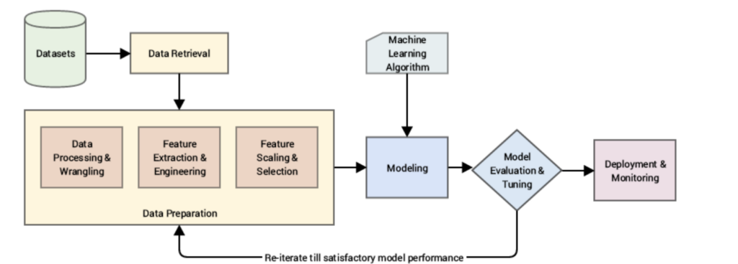

Slide 9
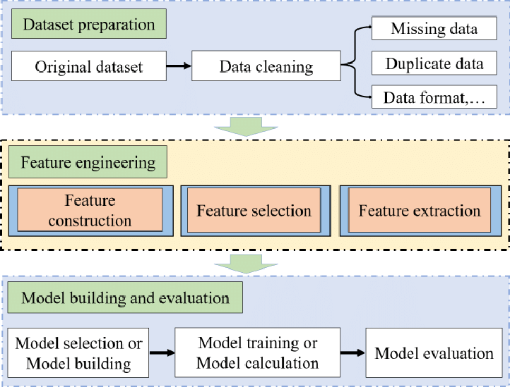

Slide 10
Thankyou

